Slide 1
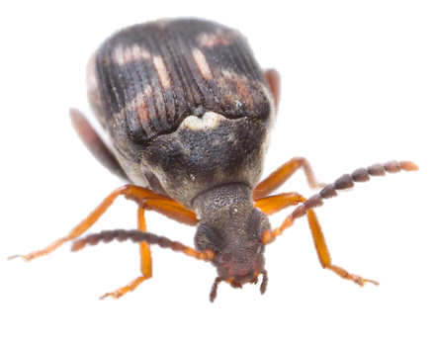
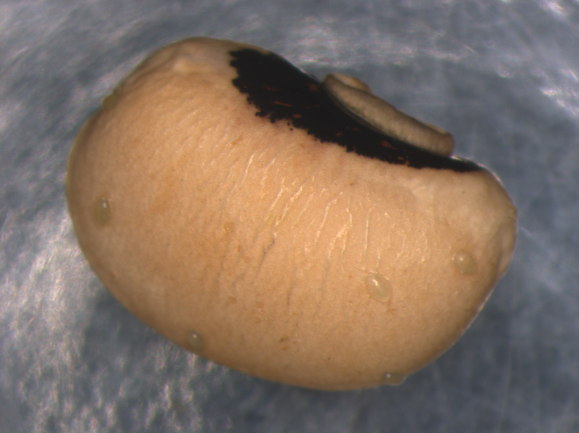
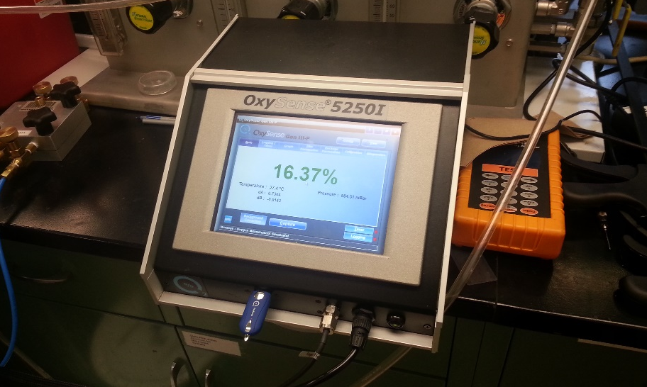
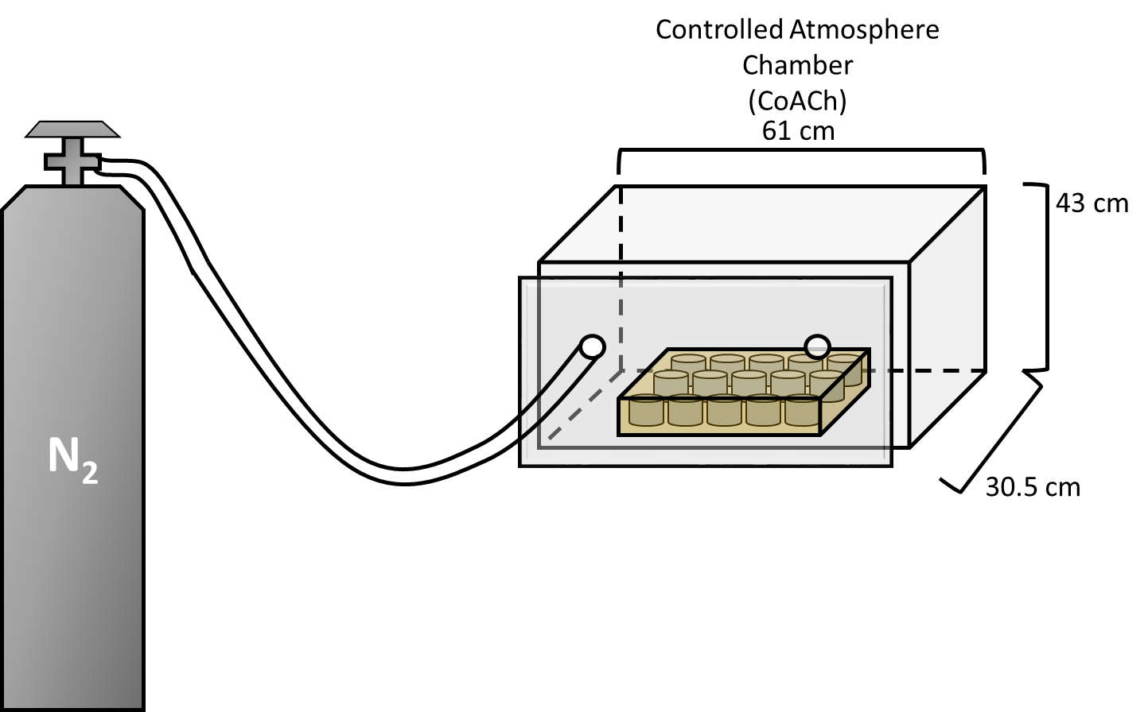
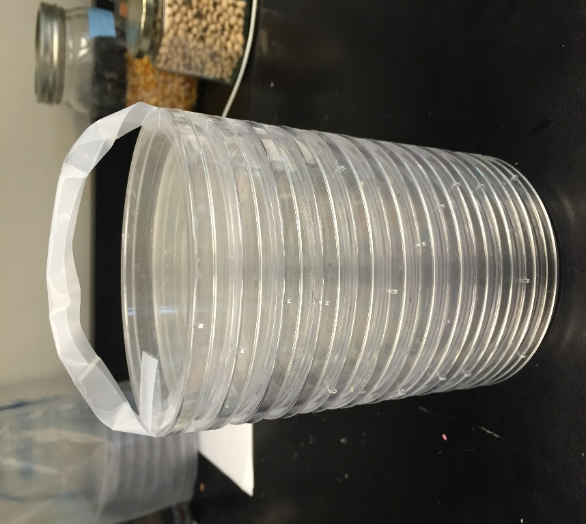
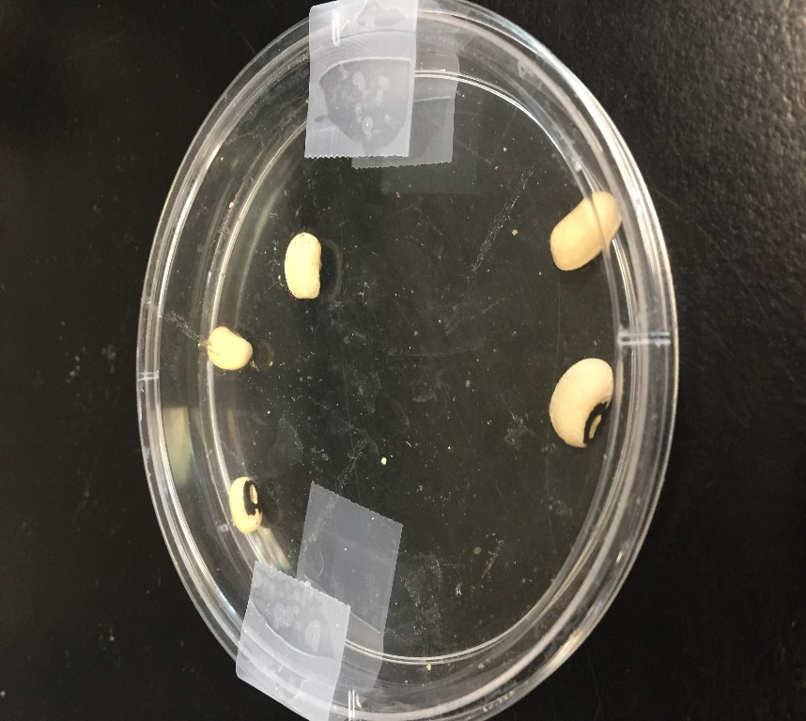
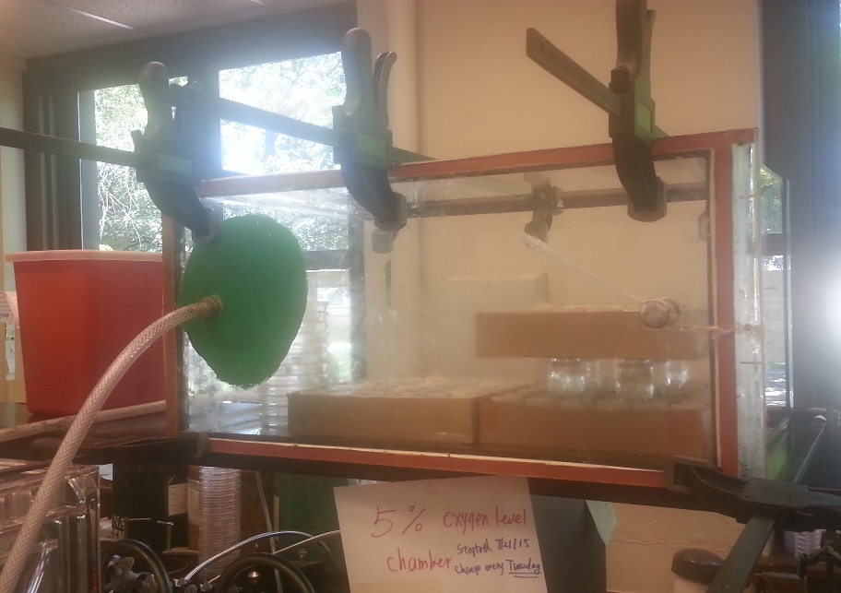
Reproductive behavior and egg development of cowpea bruchids (Callosobruchus maculatus) under hypoxia
Yan Yan^{1,2}, Scott B. Williams², Larry L. Murdock², Dieudonne Baributsa²
¹Vanderbilt University
²Purdue University
Summary
Results and Discussion
The sealed nature of hermetic containers makes studying the behavior of insects under low oxygen conditions difficult.
We exposed cowpea bruchids to decreasing levels of oxygen and observed the treatments’ effect on female oviposition and egg survival.
Reduced oxygen significantly reduced the number of eggs laid by female bruchids over their lifetime. Lower oxygen also reduced the number of eggs the successfully developed into adult insects.
2% - p= 0.114, 5% - p= 0.595, 10%- p= 0.115
2% - p= 0.246, 5% - p= 0.085
10%- p= 0.001
Introduction
Insect pests are a serious threat to the long-term storage of food for smallholder farmers in developing nations.
Hermetic containers, like the Purdue Improved Crop Storage (PICS) bag, provide a solution to dealing with insect pests in stored grain. They are effective and reasonably affordable to farmers at only $2-3 per bag.
PICS bags do not immediately kill the insects side and oxygen remains sufficiently high that they continue to be active after sealing the bags. As we cannot directly observe insect behavior in sealed bags, we set up an experiment to see how low oxygen affects oviposition behavior and ultimately population growth and development.
In the present study, we sought to shed light on the effect of hypoxic atmospheres on the reproductive behavior of C. maculatus. We sought to determine (1) the effect of lowered oxygen levels (2%, 5%, and 10% of total atmosphere) on the number of eggs laid by adult female cowpea bruchids; and (2) the effect of exposure on eventual adult emergence from eggs laid by female bruchids under hypoxia.
Figure 2. Mean number of eggs laid by female cowpea bruchids during (A) 48 and (B) 72 h of exposure to hypoxia. Asterisks represent statistically significant differences between oxygen treatment groups (blue) and paired control groups (orange). Bars with no asterisk were not significantly different from the control group. Oxygen levels had no effect on the number of eggs laid relative to the control groups with the exception of the 10% treatment group exposed for 48 h.
2% - p= 0.015, 5% - p= 0.
10%- p= 0.041
2% - p= 0.010, 5% - p= 0.023
10%- p= 0.094
Figure 1. Results of daily monitoring of egg laying by female C. maculatus under normoxic conditions. Female bruchid survival and the daily average number of eggs produced by surviving females were recorded. Egg number, Development Time, Emerged Adults, and Percentage Emerged values are averages of cohorts laid by ten female bruchids selected for this study.
Methods
Baseline study- Female survivorship and the number of eggs laid declined over time (Figure 1). The highest average number of eggs laid was 14 on Day 1 of the study. Egg production stopped after 6 days and the last female bruchid died on day 9 of the study.
There was a strong relationship between when the eggs were laid and percentage that developed in adults successfully (r= 0.89). The percentage of eggs that developed into adults was dependent on when the eggs were laid. Eggs laid earlier in a female bruchid’s lifespan showed good rates of emergence (~60%), but declined later in the female’s lifespan. Eggs laid after Day 6 did not develop into adults.
Figure 3. Average number of eggs laid by female cowpea bruchids over their lifetimes both during and following exposure to (A) 48 and (B) 72 h of exposure to hypoxia. Asterisks represent statistically significant differences between oxygen treatment groups (blue) and paired control groups (orange). Bars with no asterisk were not significantly different from the control group. We observed negative effects of our treatment oxygen levels on the reproductive output of female bruchids relative to our control groups.
Baseline Bruchid Reproductive Output
Ten, female cowpea bruchids (Callosobruchus maculatus) were selected and individually held with a pair of male bruchids in a 30-mL vial for 12 h to ensure mating.
Female bruchids were transferred to a new vial containing 5 cowpea beans and maintained under ambient oxygen and temperature conditions.
Every 24 h, the female bruchids were transferred to a new vial with 5 clean cowpeas. This process was repeated daily until all female bruchids were dead (9 days).
We counted the number of eggs laid by each female during each 24 h period. Eggs were incubated for 60 days and the number of adults that emerged by this time were counted.
Reproductive Output study- Exposure to different levels of oxygen did not result in statistically-meaningful effects on female egg laying during the time of exposure (Figure 2). Total number of eggs laid ranged between 20 and 30 eggs per female after 48 h and 15 to 40 eggs per female after 72 h. Oxygen treatment did influence life-time egg laying numbers (Figure 3) and longer exposure times enhanced this effect.
As oxygen levels decreased, the number of eggs that developed into adult bruchids after 60 days also declined (Figure 4). Increased time under lower oxygen increased the effect.
Figure 4. Average number of progeny emerged from bruchid eggs laid by female bruchids exposed to low oxygen for (A) 48 and (B) 72 h and under normal oxygen. Asterisks represent statistically significant differences between oxygen treatment groups (blue) and paired control groups (orange). Bars with no asterisk were not significantly different from the control group. The 2% and 5% oxygen treatments significantly reduced progeny development, while 10% oxygen did not result in the same effect.
Above: Cowpea bruchid (Callosobruchus maculatus)
Below: Cowpea with bruchid eggs
Effect of Reduced Oxygen on Bruchid Egg Production
Conclusions- Low oxygen environments can reduce bruchid reproduction rates as well as larval development even after female bruchids are returned to normal oxygen.
This study establishes a foundation for future understanding on how insects behaviorally respond to low oxygen environments.
Thirty-six, 3 d old, mated female bruchids were placed into individual 30 mL vials with 5 fresh cowpeas.
All vials were placed in a Controlled Atmosphere Chamber (CoACh) and exposed to either 2, 5, or 10% oxygen (v:v). Oxygen levels were confirmed using an Oxysense 5250i oxygen reader. Exposure periods lasted either 48 or 72 h.
After exposure, females were transferred into new vials with fresh seed. Females were allowed to lay eggs under normoxic conditions for an additional 48 or 72 h, depending on the treatment group.
A concurrent control group was paired with each treatment group.
Acknowledgments
I would like to thank the Purdue Improved Crop Storage Program for allowing me an opportunity to work in their lab and The China Agricultural University for supporting my research.
Above: Oxysense 5250i oxygen reader
Below: Controlled atmosphere chamber
Above: Cowpeas bearing eggs were stored in petri dish stacks for storage after exposure to treatment atmospheres (2, 5, or 10% oxygen).
Left: A schematic of the Controlled Atmosphere chamber (CoACh) with N₂ tank attachment and treatment vial placement.

